Slide 1
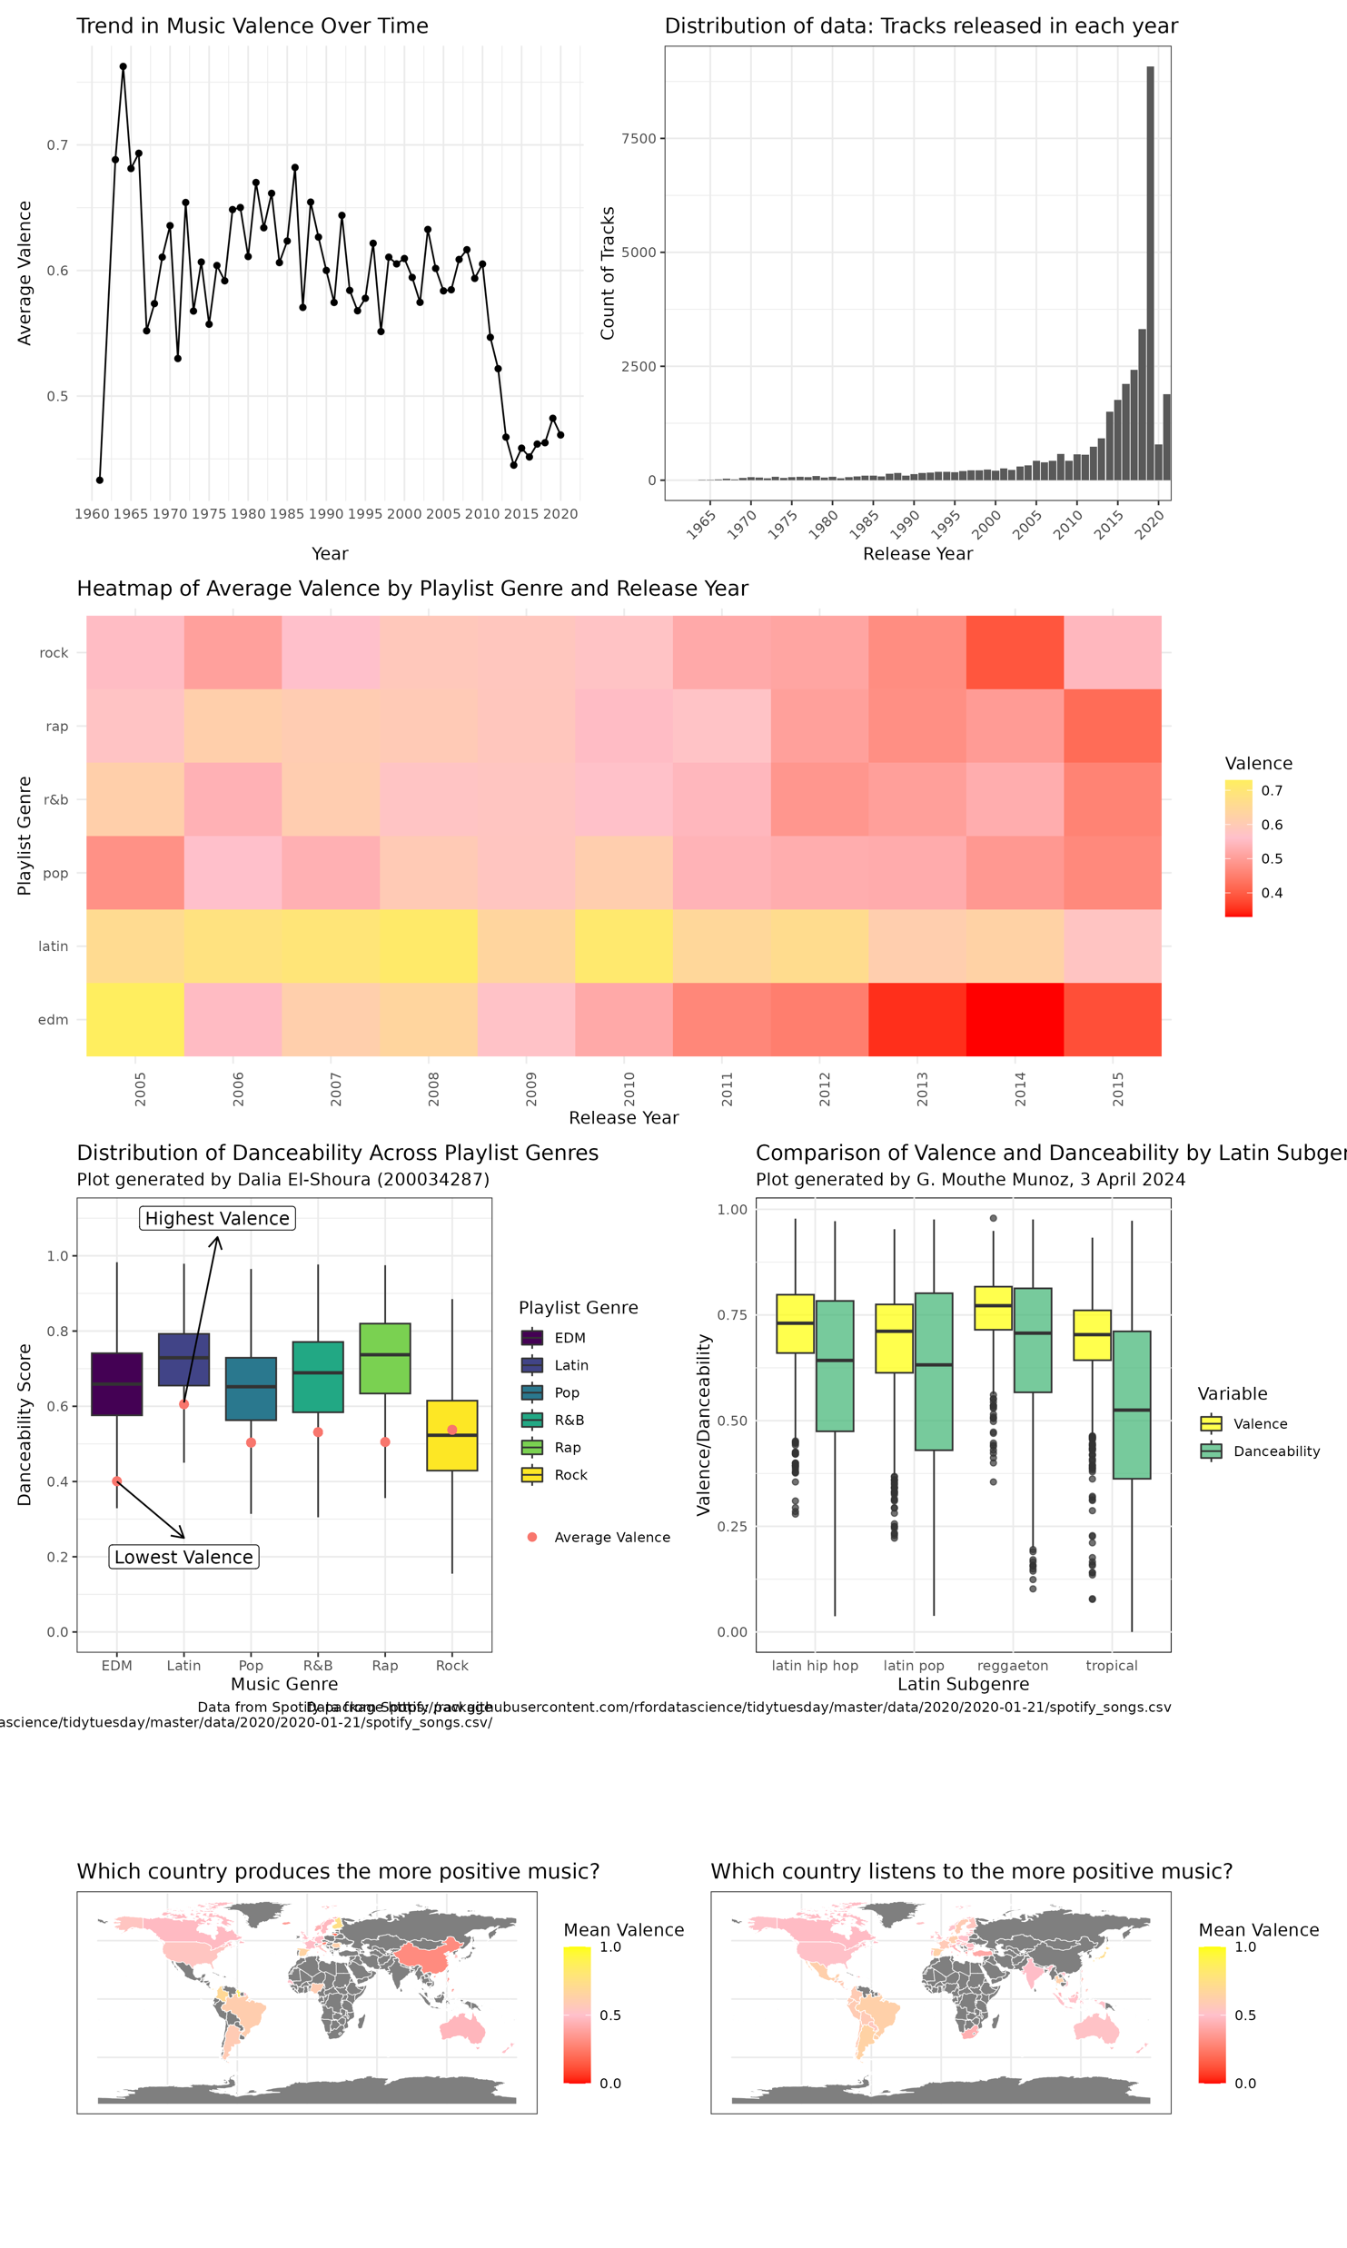


Positivity in music
Valence → A measure from 0.0 to 1.0 describing the musical positiveness.
High valence → sound more positive (e.g. happy, cheerful, euphoric),
Low valence → sound more negative (e.g. sad, depressed, angry)
https://github.com/rfordatascience/tidytuesday/blob/master/data/2020/2020-01-21/readme.md

Slide 2

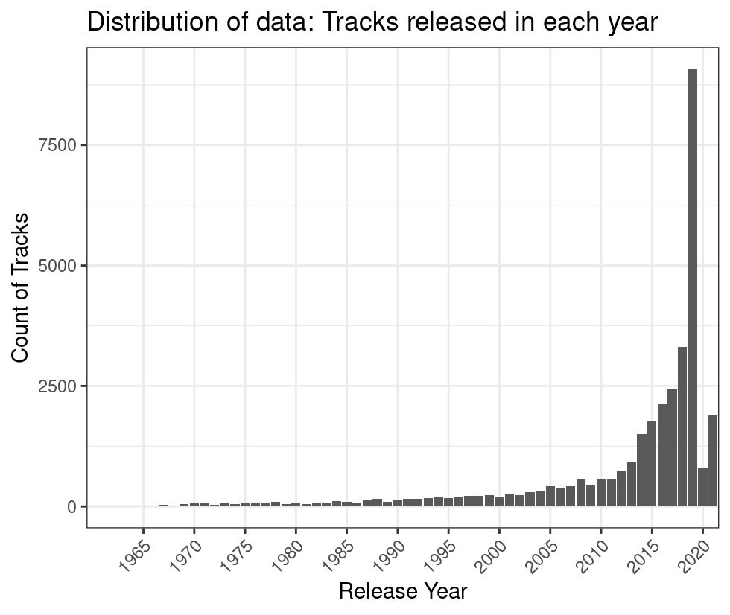
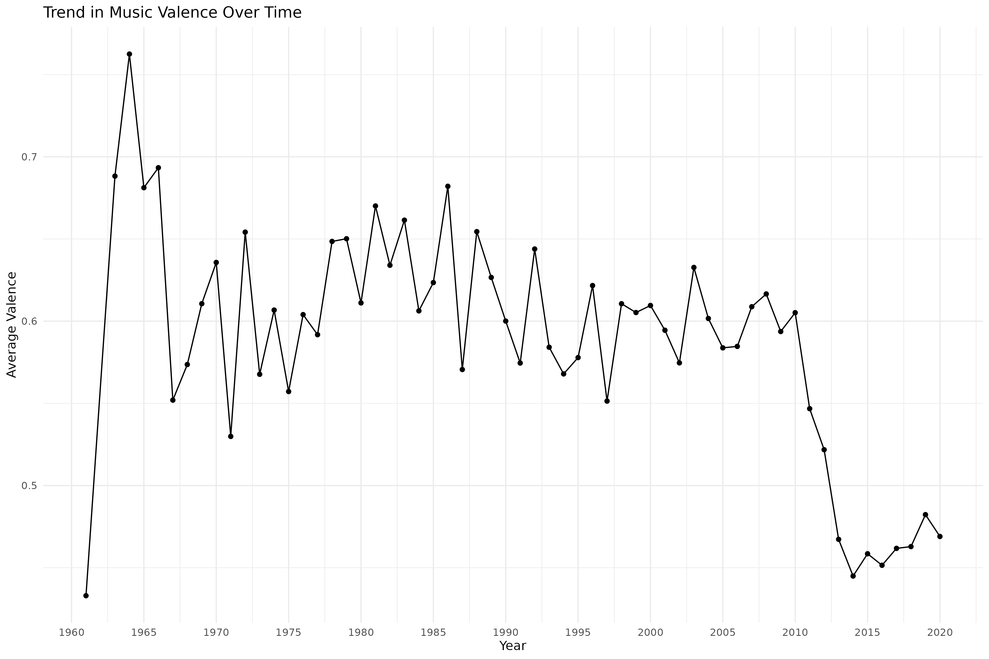
Trends in Music Valence over Time
Presented by: Hannah Behan
200463443
Notes:
This line graph indicates a general decline in music valence provided in the Spotify data set, with a large drop in 1960 and a steady decline from 2000 onwards.
There are noticeable valence fluctuations in the music over the years, this suggests a shift towards songs that have more negative emotions, .
Exploring the Emotional Landscape of Music: An Analysis of Valence Trends and Genre Variations in Spotify Music Data. (Shruti Dutta, Shashwat Mookherjee, 2023)

Slide 3
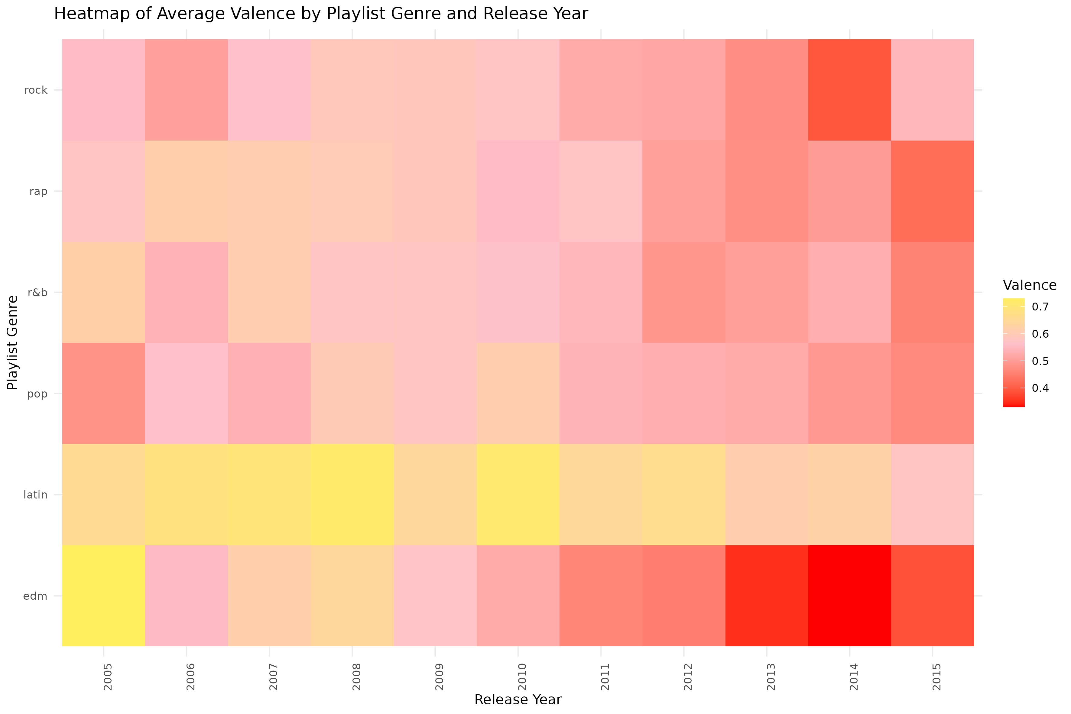
Distribution of average valence amongst each genre between 2005-2015
Presented by: Fiza Ali (210268513)

Slide 4
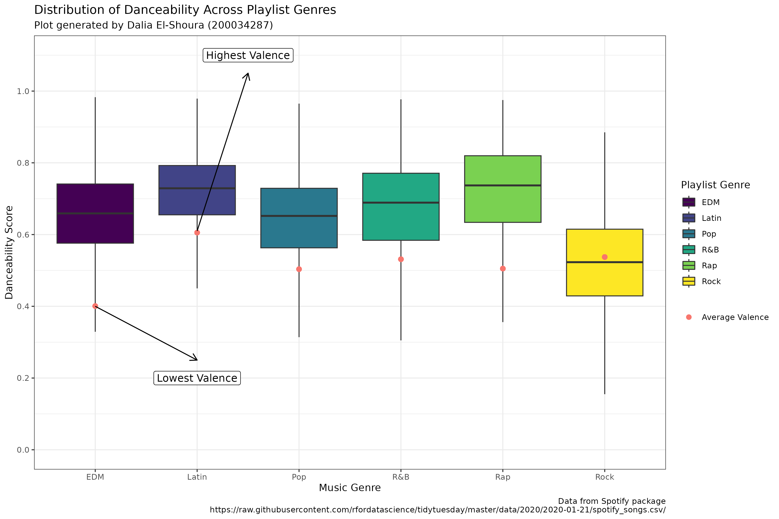
Distribution of Danceability Across Playlist Genres
Presented by: Dalia El-Shoura (200034287)

Slide 5
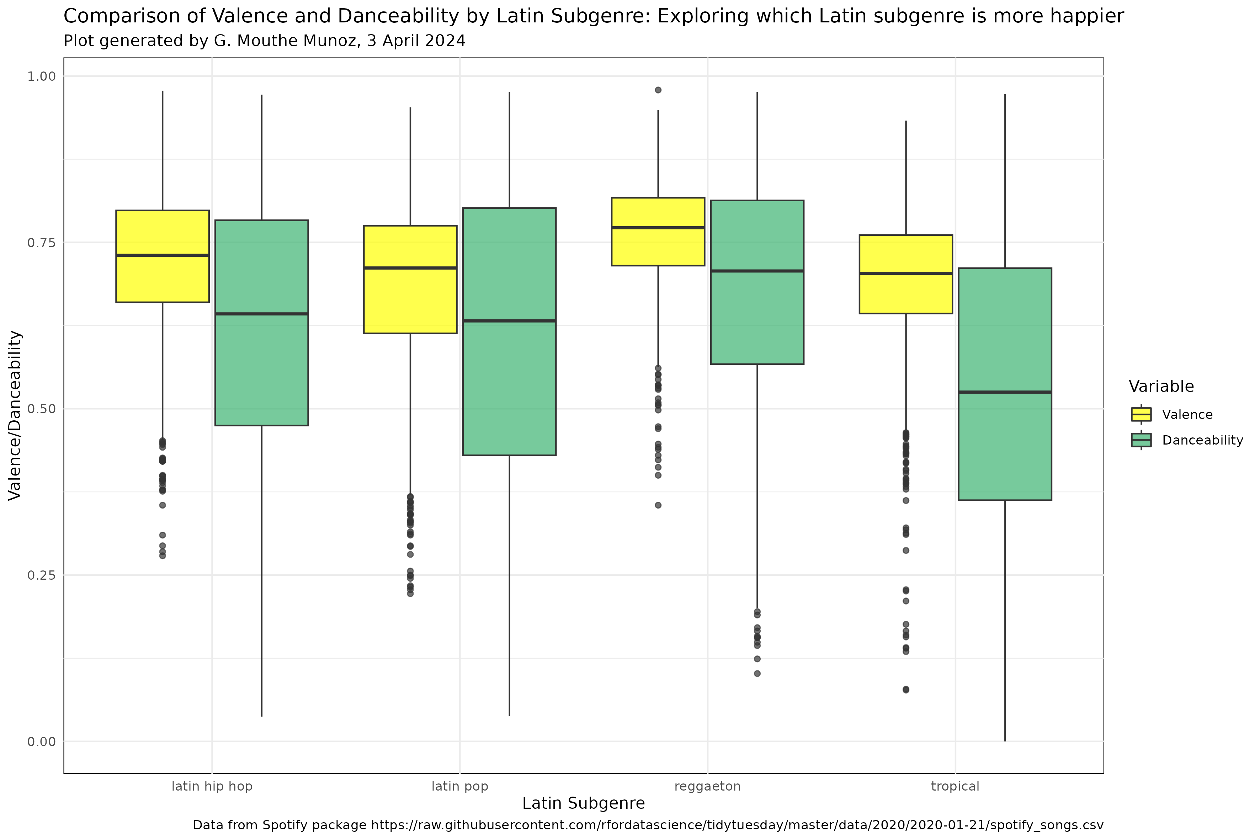
Exploring Valence and Danceability Variations Across Latin Subgenres
Presented by: Gretchel Mouthe Munoz - 210449086

Slide 6
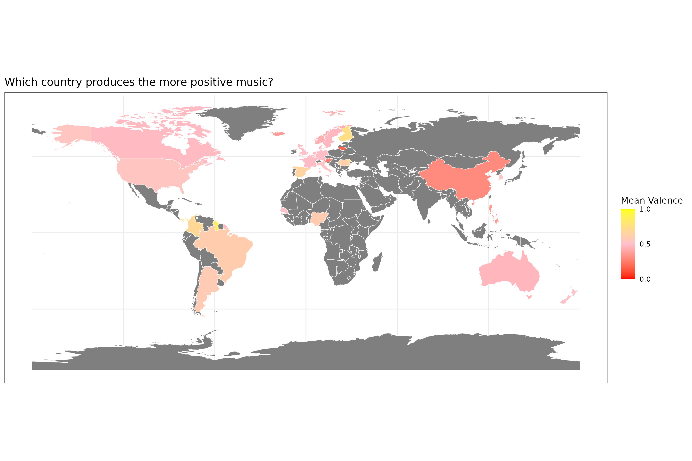
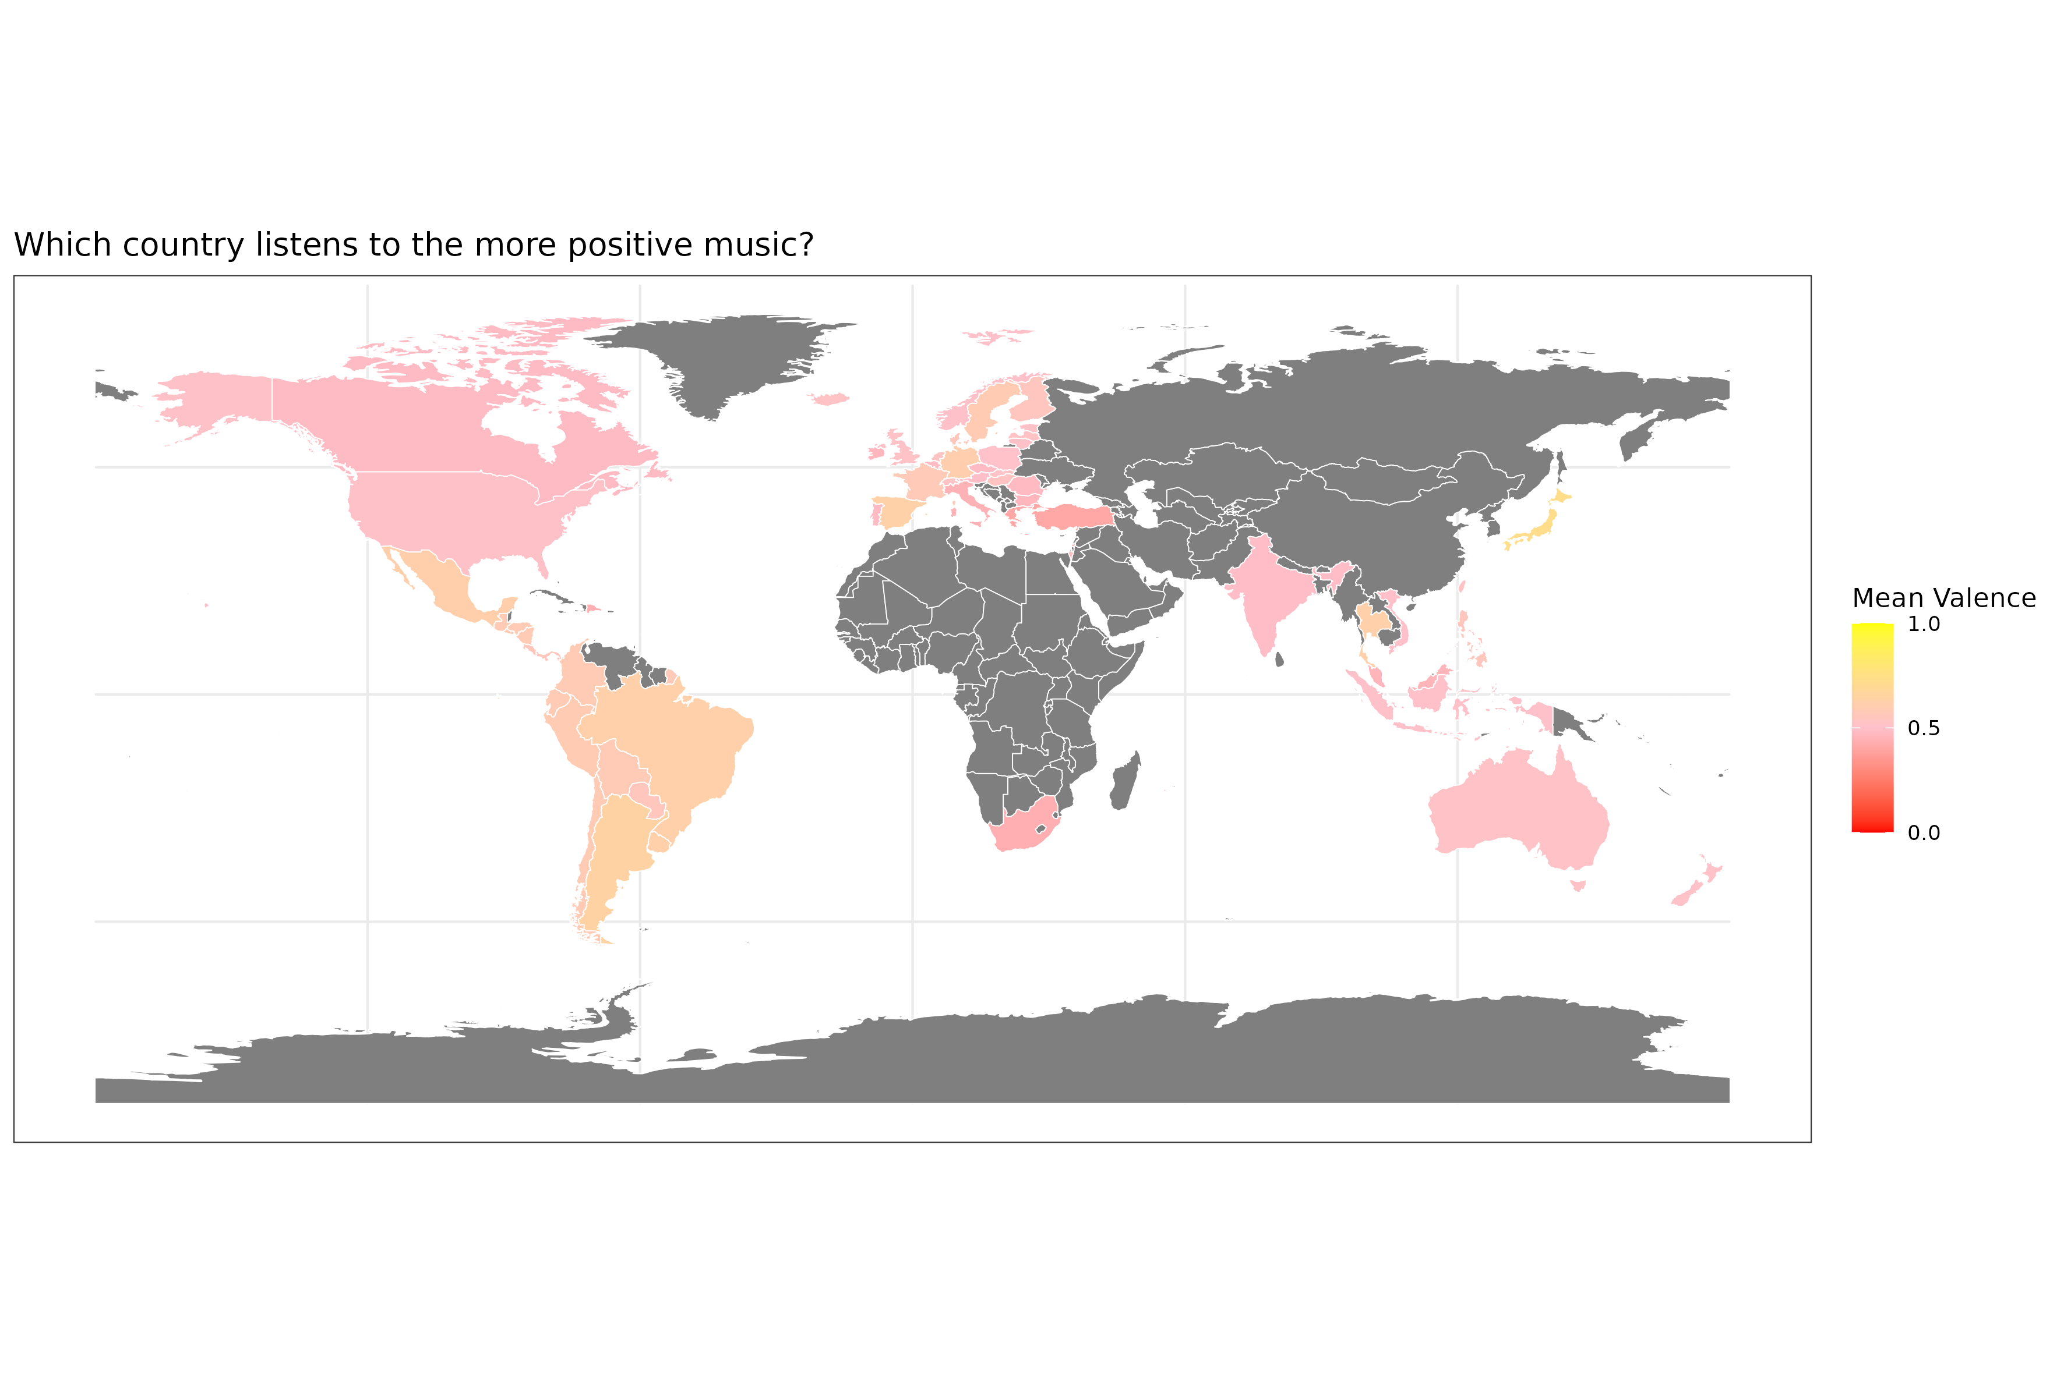
Is there a connection between valence and country?
Map 1. This map illustrates the average valence (emotional tone) of artists in relation to their native countries, using external data sourced from 'Top Charts Artists by Country' spanning the years 2000 to 2023. Each country is color-coded to represent its mean valence score. Areas shaded in grey indicate regions where data is not available.
Map 2. This map illustrates the average valence per country, derived from the top 50 songs for each country ("Top 50 Songs by Country - May 2020" dataset). Reflecting the emotional positivity of music preferred in each country during 2020. The colour gradient indicates the average valence, with red representing lower positivity (0.0) and yellow indicating higher positivity (1.0). Regions in grey represent countries without available data.
Presented by:
Luisa Shanti Defiebre - 210535530
References for external data:
Figure 1: Hedizekri (no date) Top Charts Artists by Country. Available at: https://www.kaggle.com/datasets/hedizekri/top-charts-artists-country (Accessed: [02/04/2024]).
Figure 2: Kapoor, H. (no date) Spotify Top Songs by Country - May 2020. Available at: https://www.kaggle.com/datasets/hkapoor/spotify-top-songs-by-country-may-2020 (Accessed: [02/04/2024]).

Slide 7

Enjoy the “happy” music! & Thank you for listening.
Ahora te peudes marchar – By Luis Miguel
Valence: 0.909
Danceability: 0.780
Group A: Hannah Florence Catherine Behan Fiza Ali Dalia El-Shoura Gretchel Mouthe Munoz Luisa Shanti Defiebre

